Slide 1
Biochemistry/Organic Chemistry
Campbell 9th edition
Chapter 4/5
Notes:
Thank you for downloading my powerpoint! There will be speaker notes at the bottom of each slide which includes anything in lecture that isn’t on the slides! Good luck studying :) -Brian X

Slide 2
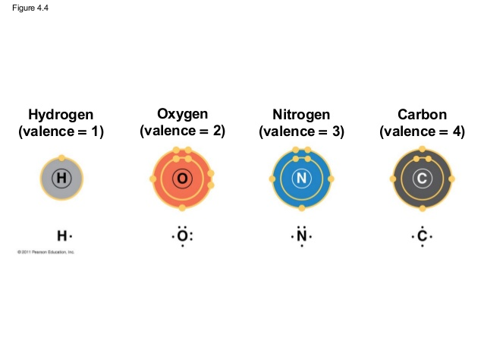
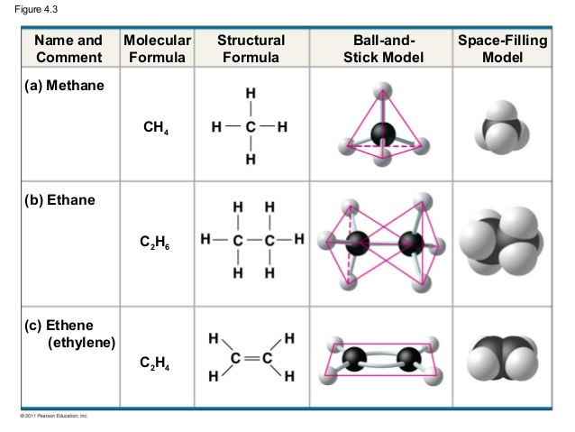
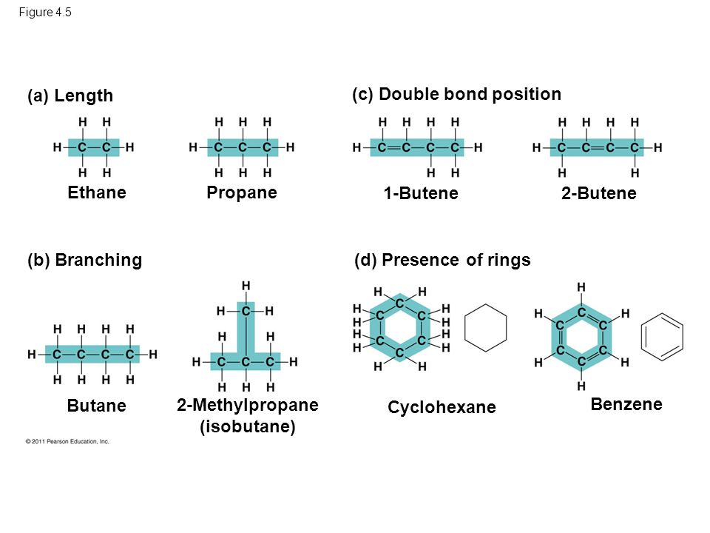
Orgo
Carbon: backbone of life
Living organisms consist primarily of carbon
Proteins, DNA, carbohydrates, etc
C can bond to four other atoms
Frequently H, O, and N
Hydrocarbons
Molecules of hydrogen and carbon only
Hydrogens are implicit
Storage of energy in their covalent bonds
Repelling force in nuclei of H cause tetrahedral
Double bond between C causes planar
Notes:
Carbon has 4 valence (outer ring) electrons, and each of those can be shared in a covalent bond
Hydrogens are implicit, meaning that when writing out the organic structure, you do not need to write out the H and any carbon with less than 4 bonds formed is assumed to have Hs taking the remaining bonds
Double bonds take up 2 valence electrons (as much as 2 single bonds, you can think of them being 2 single bonds) and triple bonds take 3

Slide 3
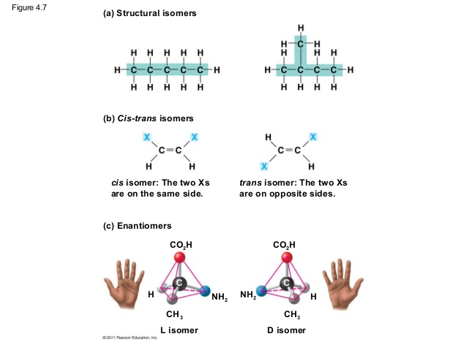
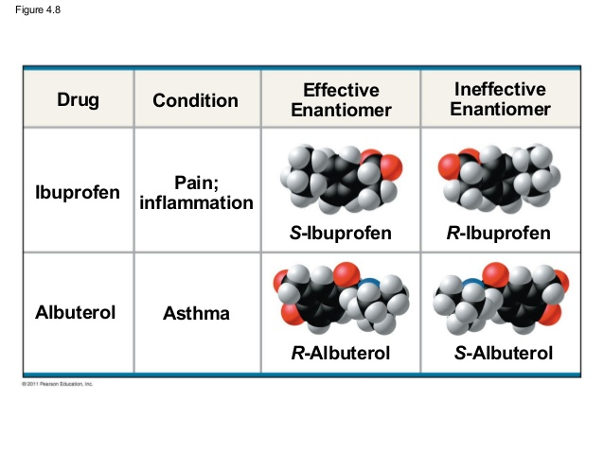
Isomers
Same molecular formula different structures
Structural - different covalent arrangements
Cis-trans - different spacial arrangments
Enantiomers - mirror images
Enantiomers
Two systems of naming R/S & L/D
Not always translational
R/S refers to chiral centers
Enantiomers of a different drug may have different effects
Organisms are sensitive to even subtle variations
Naming Chiral Centers: https://www.chem.purdue.edu/courses/chm25500/handouts/chiral_center_priority_rules.pdf
Cool site: http://www.chem.ucalgary.ca/courses/351/Carey5th/Ch07/ch7-1.html
Notes:
Structural are just different formations, Cis Trans are swaps of certain atoms, Enantiomers are mirrored
RS is latin for right and left, referring to the counterclockwise or clockwise direction (see link Naming Chiral Centers for more detail)
LD is for life death, you can figure out which one is biologically functional
L or D does not mean R or S, different naming methods

Slide 4
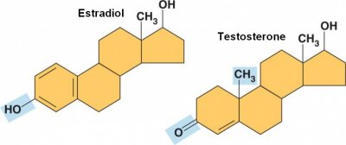
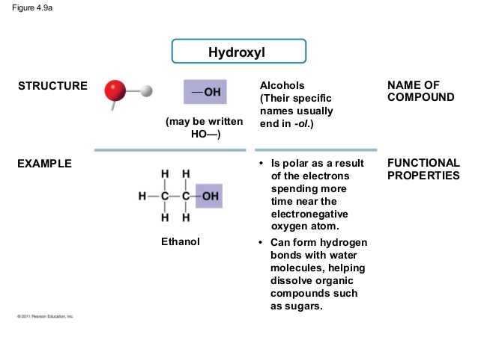
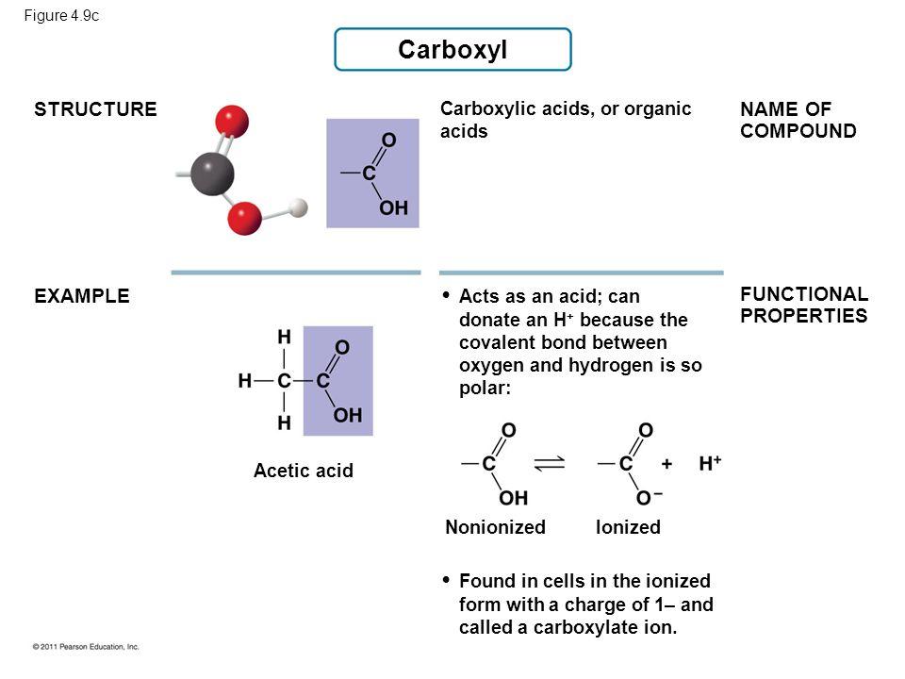
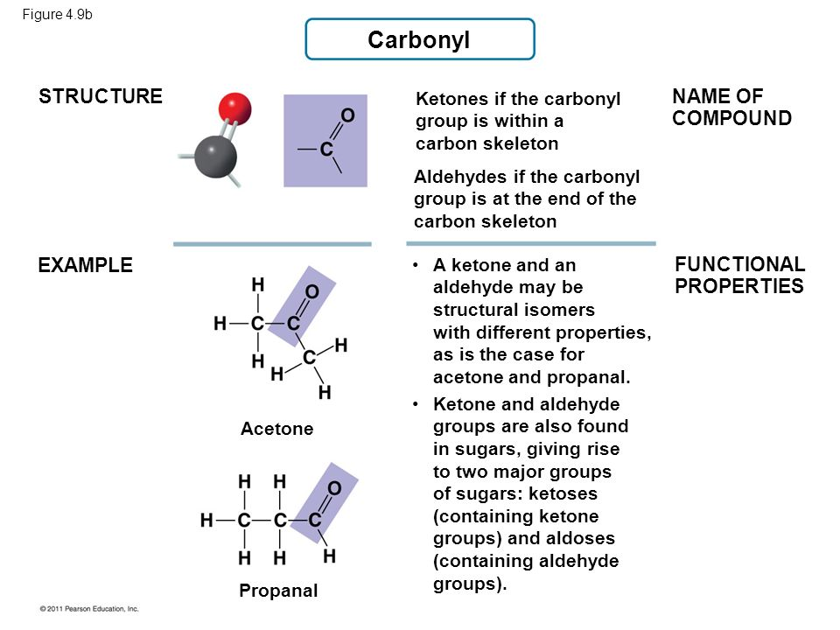
Functional Groups
Components of organic molecules responsible for reactions
Number and arrangement of groups gives unique properties
Typically replace hydrogens or are built into skeleton
Notes:
Just remember these 7 functional groups! The next 4 are on the next slide :)

Slide 5
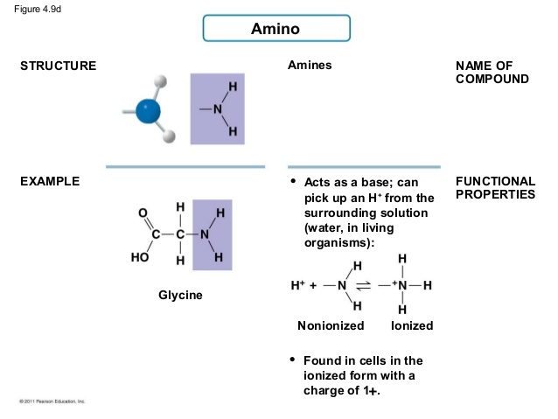
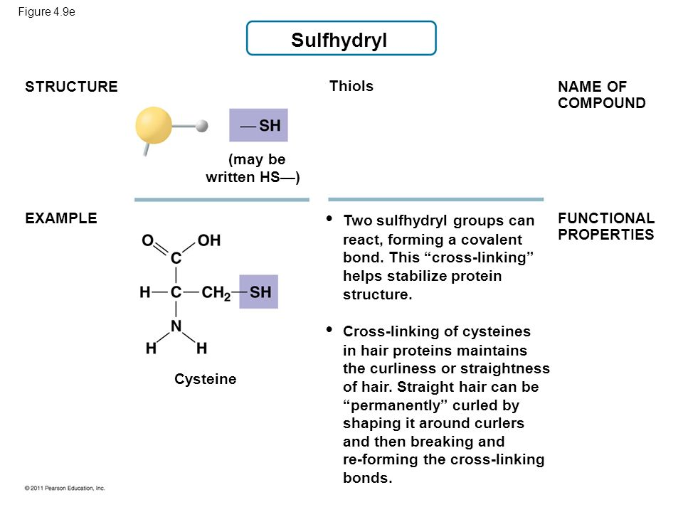
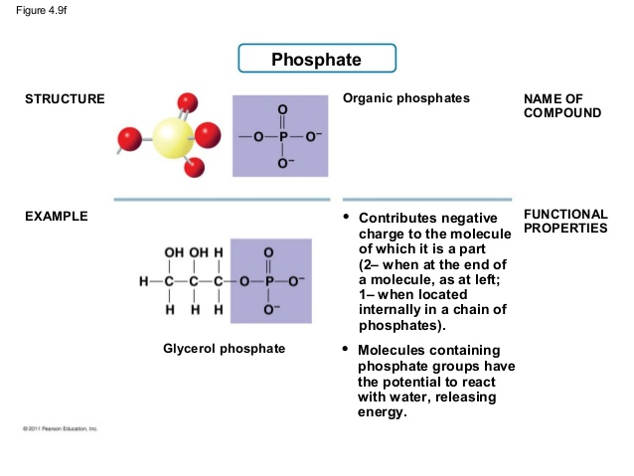
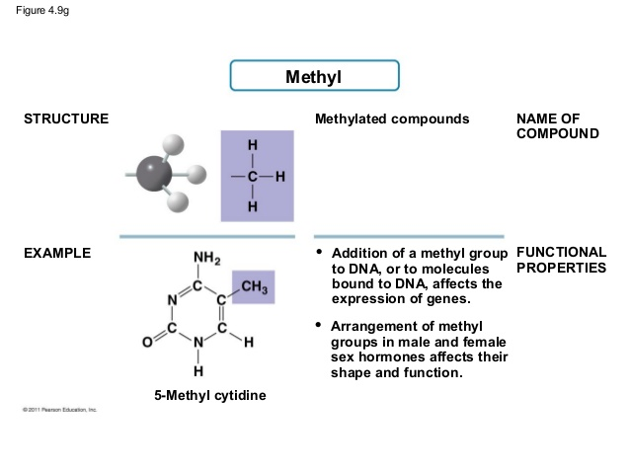
Notes:
Functional Groups :)

Slide 6
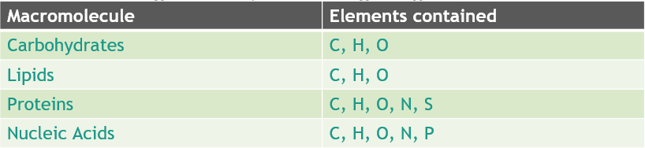
Macromolecules
Carbohydrates, proteins, and nucleic acids
Lipids are not huge
Built from polymers (poly-many, meros-part)
A repeating unit is referred to as a monomer
Notes:
Macromolecules are pretty big, typically a repetition of one small part
Different types in the table

Slide 7
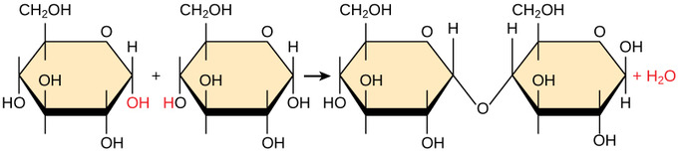
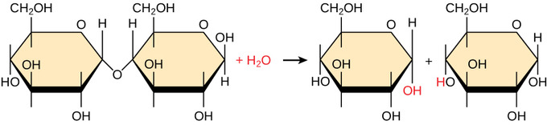
Synthesis and Breakdown of Polymers
Facilitated by enzymes
Monomers are combined through dehydration synthesis and polymers are broken through hydrolysis
In digestion, polymers are broken by enzymes
Monomers absorbed into bloodstream
Cells reform the polymers
Notes:
Dehydration synthesis is when in two polymers, one has an OH and one has an H and they are removed, forming a bond where they once were and releasing hydrogen as a byproduct (If this doesn’t make sense there are loads of videos online!)
Hydrolysis is dehydration synthesis but backwards

Slide 8
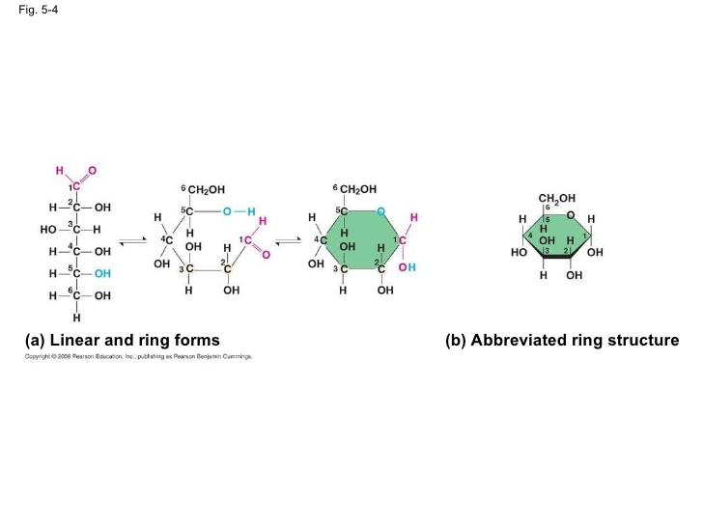
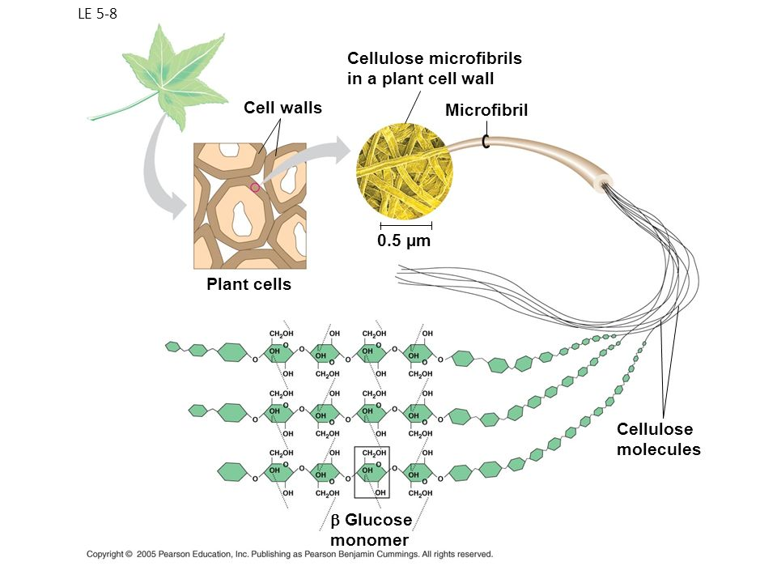
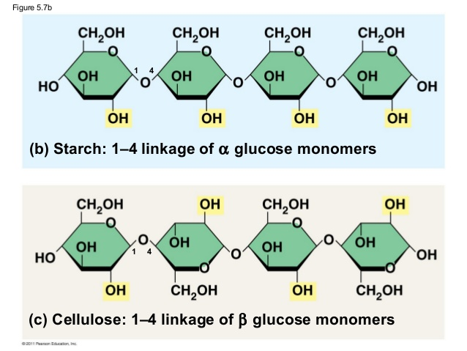
Carbohydrates
Sugars for energy (less than lipids) or for structure
Monosaccharides, disaccharides, oligosaccharides, polysaccharides
Glycosidic linkage - covalent bond between monosaccharides from dehydration
Carbonyl (Aldose vs Ketose), Multiple Hydroxyl
Monosaccharides - Linear vs chain form
Polysaccharides - Storage of glucose as starch in plants
Hydrolysis of starch breaks bonds releasing energy
Animals store glycogen
Structure - glucose (alpha) vs cellulose (beta) in plant cells
Chitin - arthropod exoskeletons - combines with calcium carbonate to harden
Notes:
Mono - 1, Di - 2, Oligo - few, Poly - many
Every sugar has a carbonyl (either aldose sugar or ketose sugar depending on if it has an aldehyde or ketone group which are specific types of carbonyl) and one or more hydroxyl group
Linear vs Chain mono - The ring form is more stable and is the standard state, the reaction for converting between forms is in the diagram in upper right
Glucose alpha vs Glucose Beta, Glucose beta = cellulose. Cellulose has OH alternating on both sides compared to the OH on one side of glucose, this allows hydrogen bonds (which are weak intermolecular attraction forces) to form between lines, and
they add up causing the overall structure to be stronger.

Slide 9
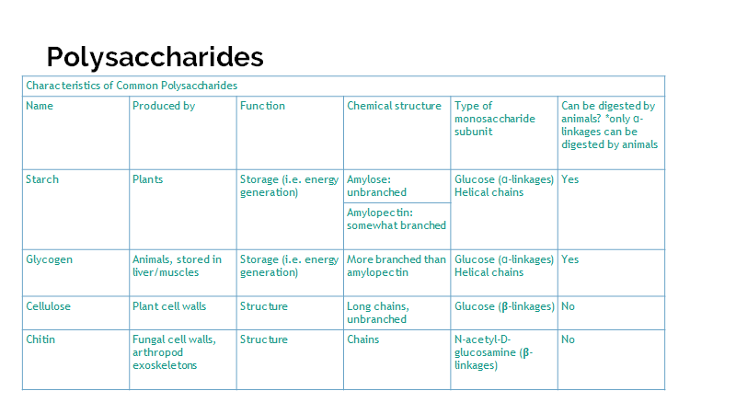
Notes:
Table of polysaccharides you should remember :)

Slide 10
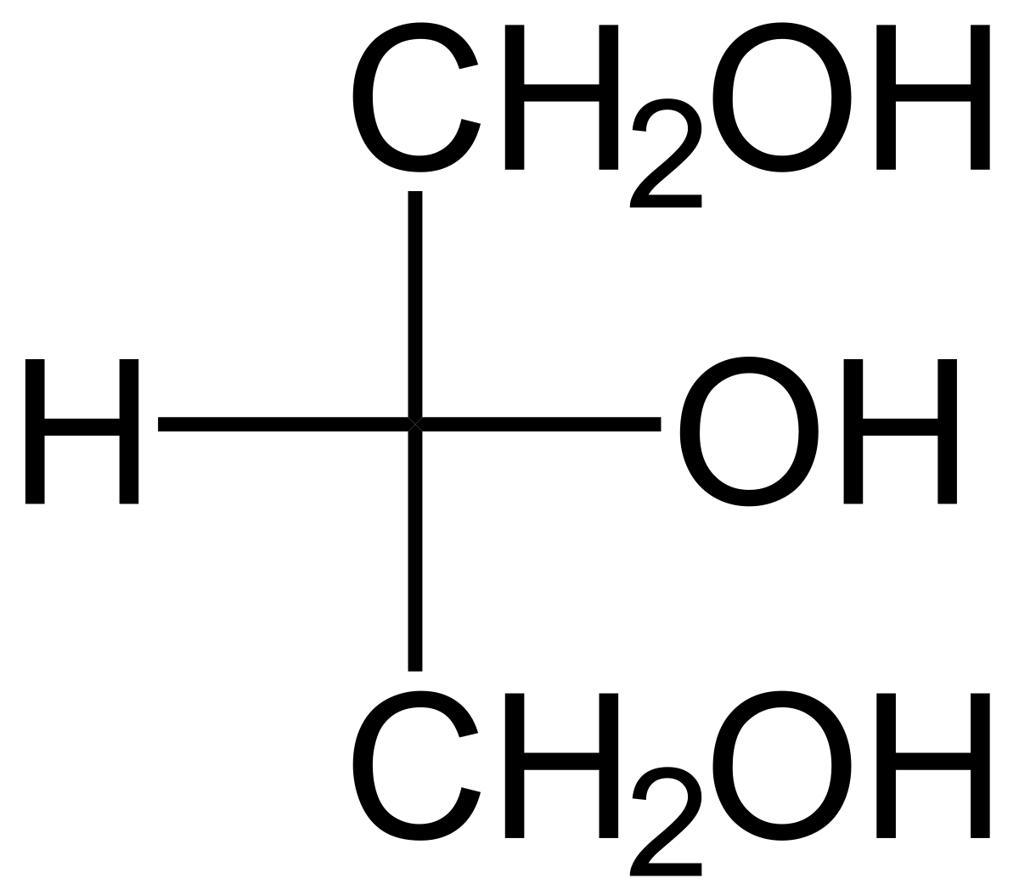
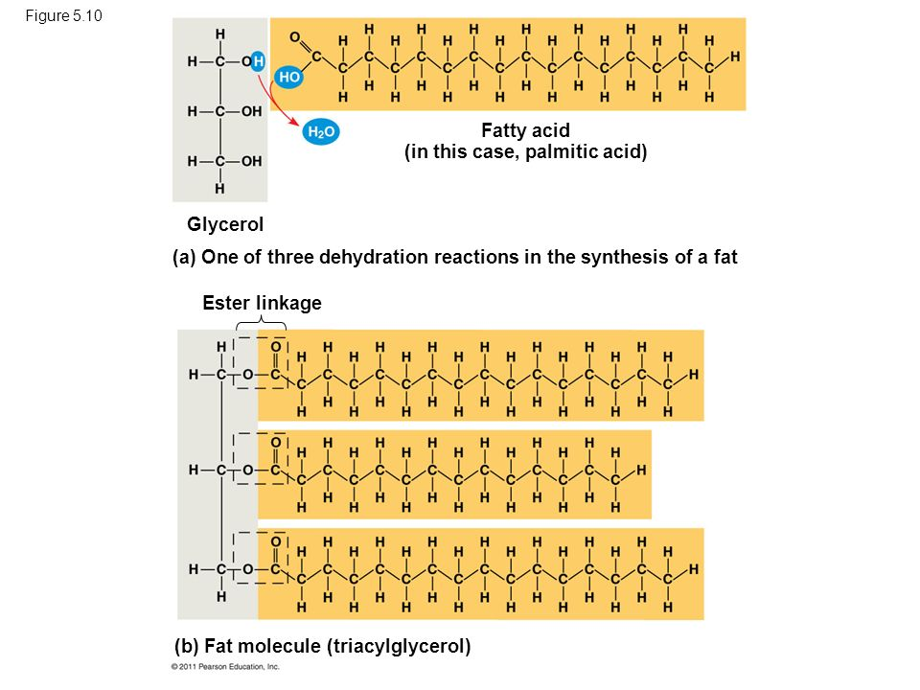
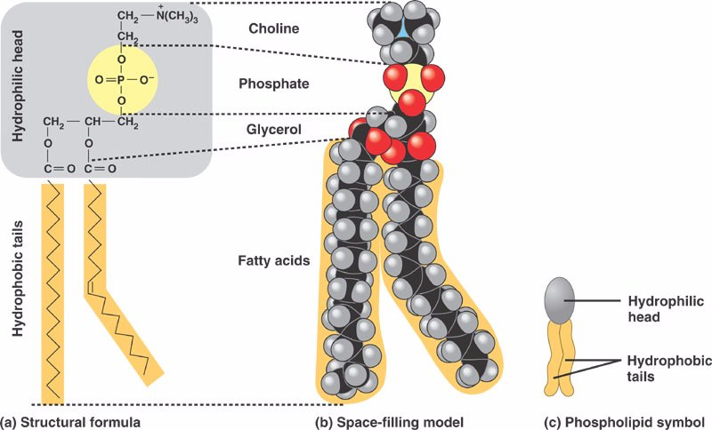
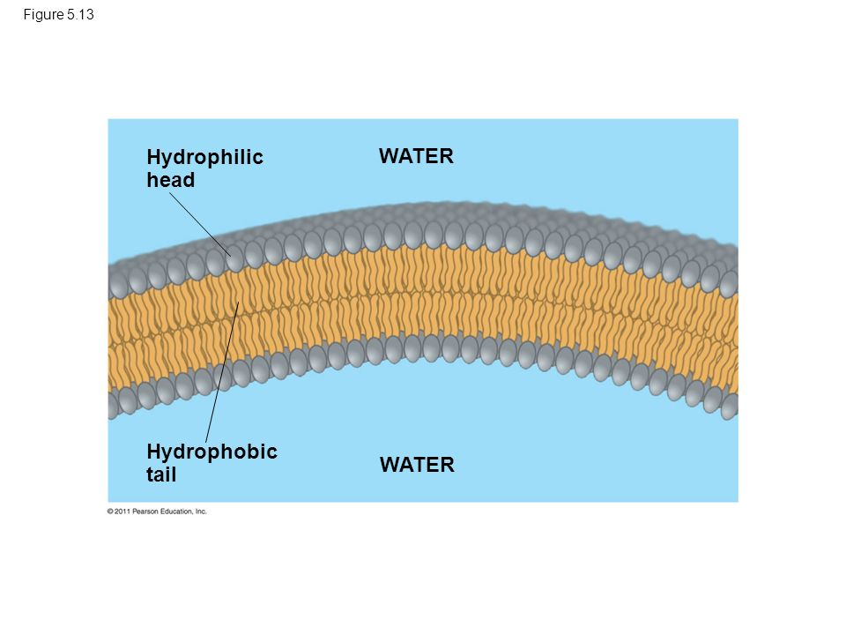
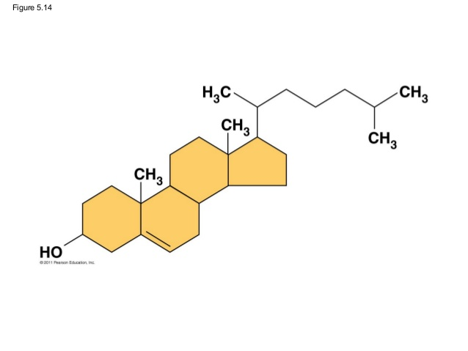
Lipids
Triglycerides (fats & oils) energy storage
Glycerol & 3 fatty acid chains
Saturated - as much H as possible
Unsaturated have double/triple bonds (more liquid)
Ester bond (reversible if needed)
Hydrophobic
Phospholipids
Negatively charged phosphate group attached to hydroxyl of glycerol makes one end hydrophobic
Bilayers
Steroids
4 hydrocarbon rings
Functions as membrane stabilizers and hormones
Cholesterol precursor of other steroids
https://employees.csbsju.edu/cschaller/Principles%20Chem/molecules/IMcommonbiol.htm
Notes:
Lipids are pretty basic :) Everything is on the slide

Slide 11
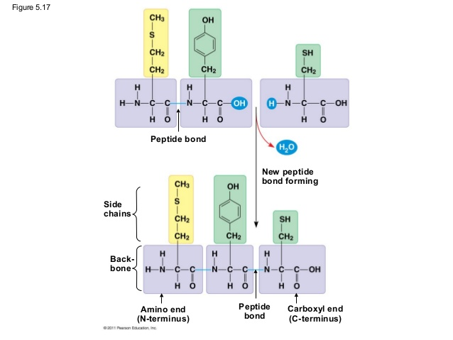
Proteins
Enzymes (catalysts) are proteins
Polypeptide chains of amino acids
Amino end and Carboxyl end
Levels of structure:
Primary: sequence of a polypeptide chain
Secondary: alpha helices/beta sheets, formed by hydrogen bonding within peptide backbone
Alpha Helix VS beta PS depends on whether repeating, or reversed
Tertiary: side chain interactions (H-bonding, ionic bonds, disulfide bridges, etc.)
Quaternary: multiple tertiary structures interacting
Fibrous proteins: mainly secondary structure
Globular proteins: tertiary structure
Chaperonins (Chaperone proteins): help proteins fold
Denaturation: loss of all structure except primary
Happens at high pH or high temperatures
Notes:
Image top right shows how peptide bonds are formed
Polypeptide is not equal to protein (Think of a ball of yarn vs a sweater, one doesn’t do much)
After denaturation, if remains dissolved can often renature

Slide 12
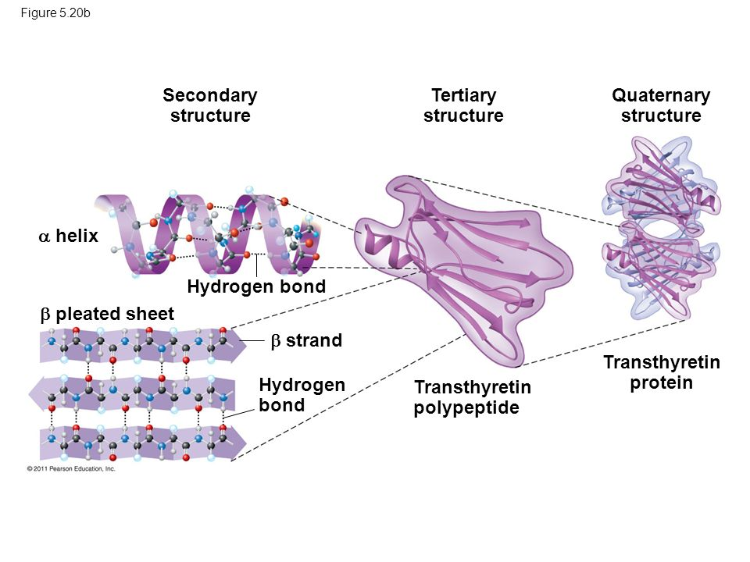
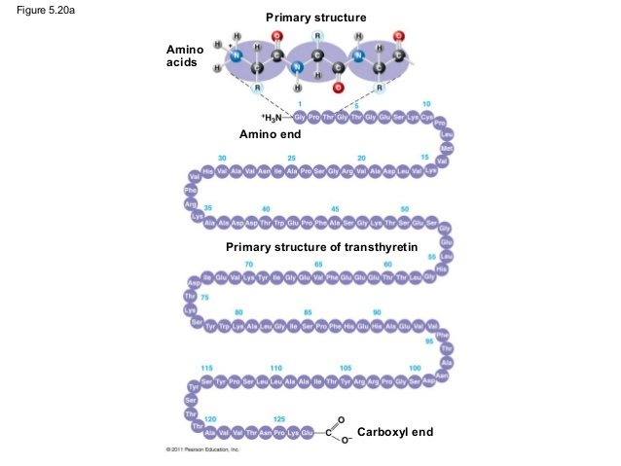
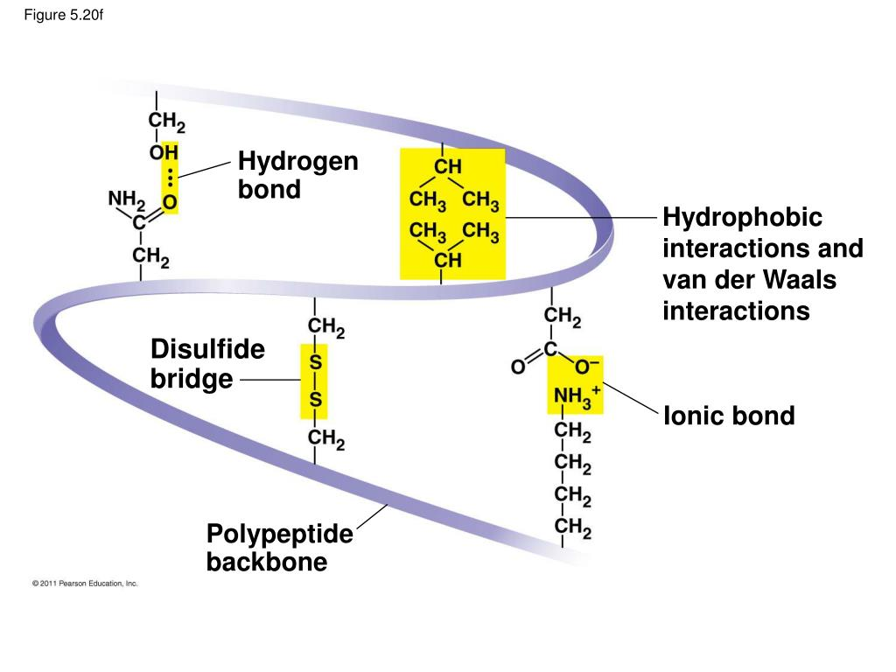
Notes:
Secondary structure may be either as an alpha helix or beta pleated sheet and is caused by hydrogen bonding between repeating amino acid groups
One protein does not have to be only an alpha helix or only a beta PS, it depends on the section that is repeating.
Alpha Helix VS beta PS depends on whether repeating, or reversed
Tertiary structure has hydrogen bonds, repulsion forces between atoms that are too close, disulfide bridges (formed two cysteine, which is an amino acid, monomers as they both have a sulfhydryl group)

Slide 13
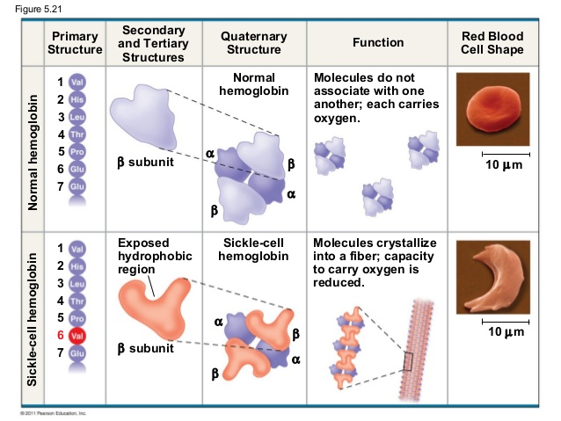
Notes:
Quick mention of sickle cell anemia
One small change can have a BIG impact.

Slide 14
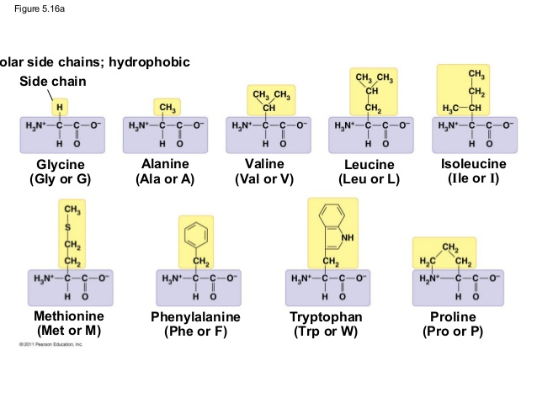
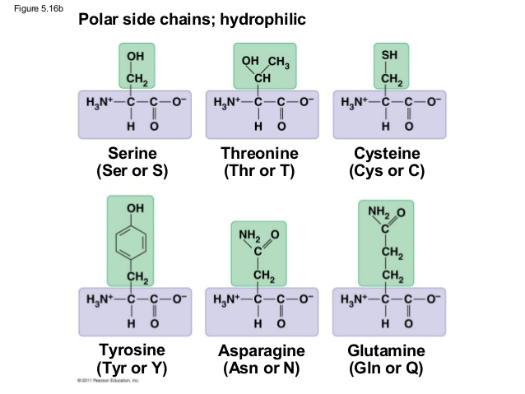
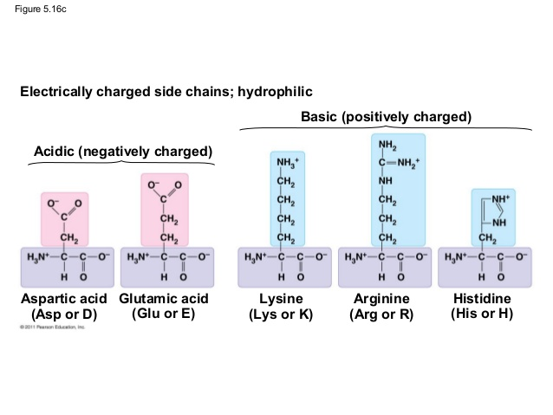
Nonpolar side chains;
Notes:
These are the 20 amino acids! No need to memorize all of them

Slide 15
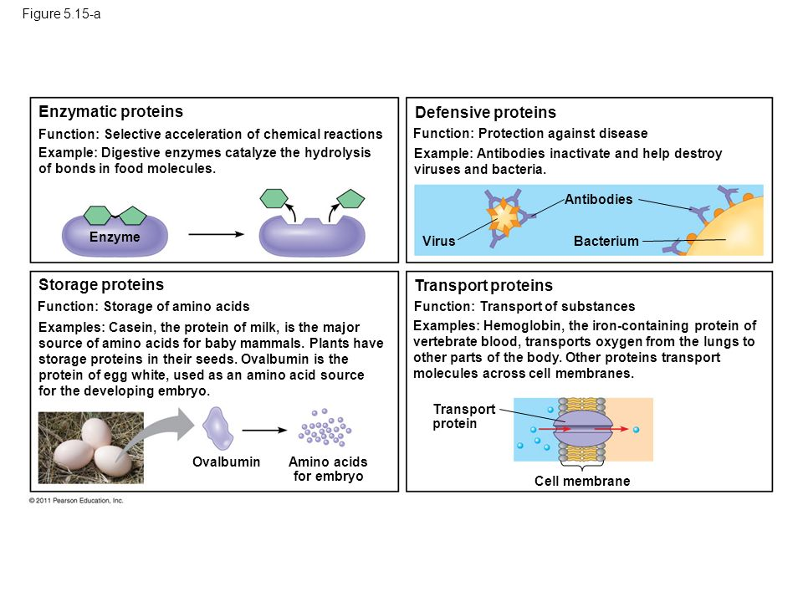
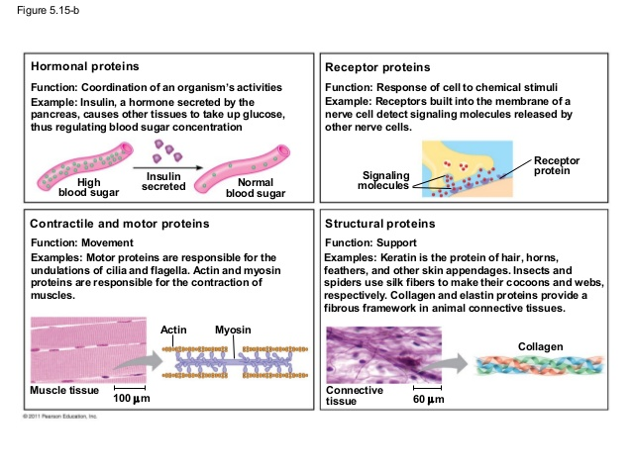
Notes:
Some protein functions :)

Slide 16
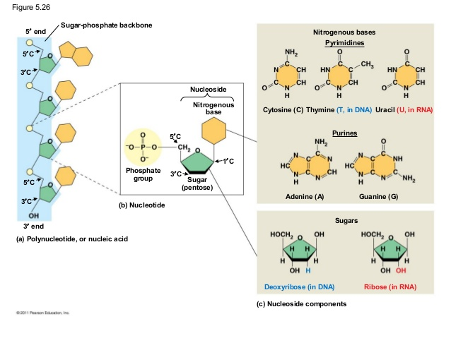
Nucleic Acids
Polynucleotides made from nucleotides
Nucleotide: 5 carbon sugar aka pentose, one or more phosphate groups, nitrogenous base
DNA and RNA
RNA has ribose (more oxygen more reactive) DNA has deoxyribose (more stable)
Sugar-phosphate backbone, 2 antiparallel complementary strands held by H bonds
Purine and Pyrimidine
Pyrimidine has one 6 membered ring of carbon and nitrogen (CTU)
Purines are larger 6 membered ring fused with a 5 membered ring (AG)
Notes:
When you start talking about DNA you want to talk about all of it. Replication is part of cell cycle which is part of molecular genetics
DNA → RNA → protein is from cell biology
Uracil is just the replacement of Thymine in RNA

Slide 17
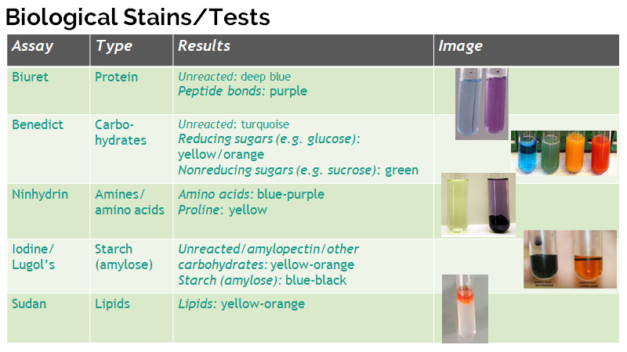
Notes:
A couple lab tests to determine the presence of a certain substance in a solution.

